Slide 1
Classification: Logistic Regression
From:
DS100 UC Berkeley

Slide 2
Goals for this Lecture
Moving away from linear regression – it’s time for a new type of model
Introduce a new task: classification
Deriving a new model to handle this task

Slide 3
Agenda
Regression vs. Classification
The Logistic Regression Model
Cross-Entropy Loss

Slide 4
Agenda
Regression vs. Classification
The Logistic Regression Model
Cross-Entropy Loss

Slide 5
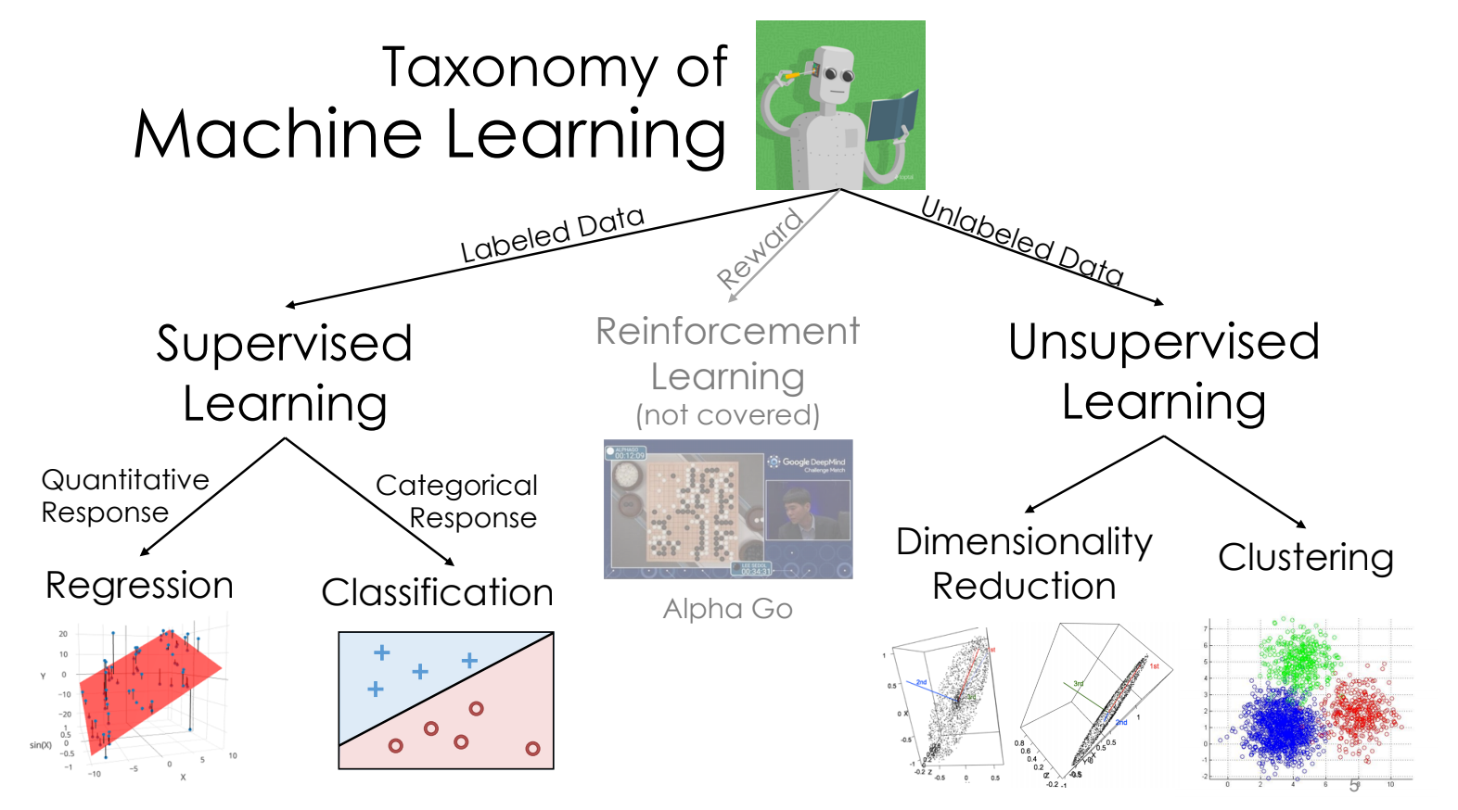
Beyond Regression

Slide 6
Beyond Regression
This week
Next weeks
Next weeks
✅

Slide 7
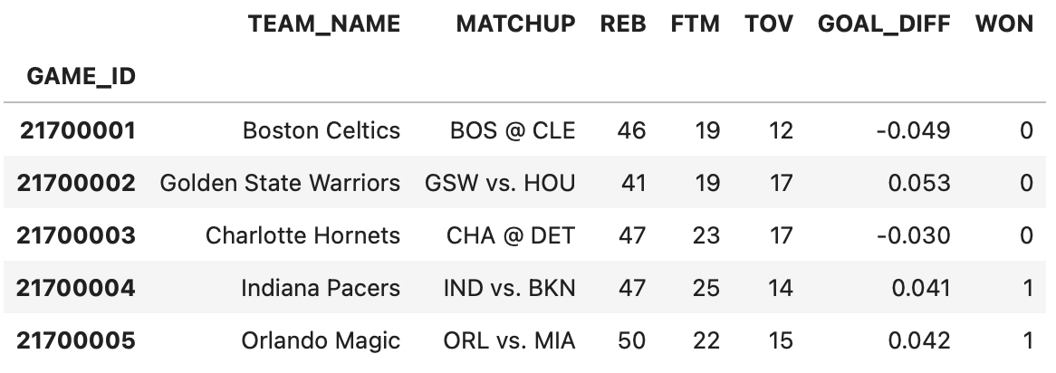

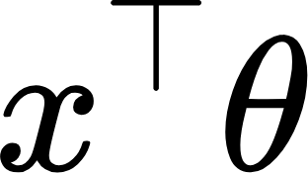
So Far: Regression
In regression, we use unbounded numeric features to predict an unbounded numeric output.
-∞
∞
Input: numeric features
Model: linear combination
Output: numeric prediction
Examples:
Predict goal difference from turnover %
Predict tip from total bill
Predict mpg from hp

Slide 8

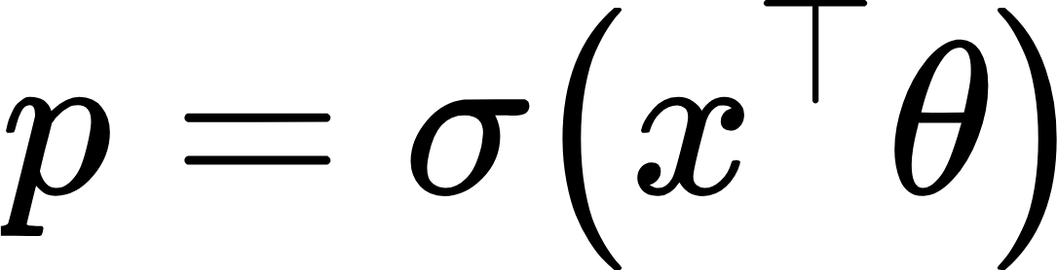
Now: Classification
In classification, we use unbounded numeric features to predict a categorical class.
Examples:
Predict which team won from turnover %
Predict day of week from total bill
Predict model of car from hp
Win?
If p > 0.5: predict a win
Other: predict a loss
Model: linear combination transformed by non-linear sigmoid
Input: numeric features
Decision rule
Output: class
An aside: we will use logistic “regression” to perform a classification task. Here, “regression” refers to the type of model, not the task being performed.

Slide 9


Kinds of Classification
We are interested in predicting some categorical variable, or response, y.
Binary classification
Two classes
Responses y are either 0 or 1
win or lose
disease or no disease
spam or ham
Multiclass classification
Many classes
Examples: Image labeling (Pishi, Thor, Hera), next word in a sentence, etc.
Structured prediction tasks
Multiple related classification predictions
Examples: Translation, voice recognition, etc.
Our new goal: predict a binary output (y_hat = 0 or y_hat = 1) given inputted numeric features

Slide 10
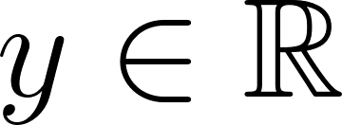
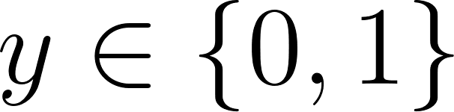
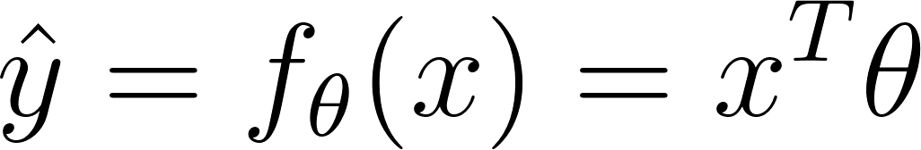
The Modeling Process
Regression ( )
Classification ( )
1. Choose a model
Linear Regression
??
2. Choose a loss function
Squared Loss or Absolute Loss
??
3. Fit the model
Regularization Sklearn/Gradient descent
Regularization Sklearn/Gradient descent
4. Evaluate model performance
??
(next lecture)
R², Residuals, etc.

Slide 11
Agenda
Regression vs. Classification
The Logistic Regression Model
Cross-Entropy Loss

Slide 12
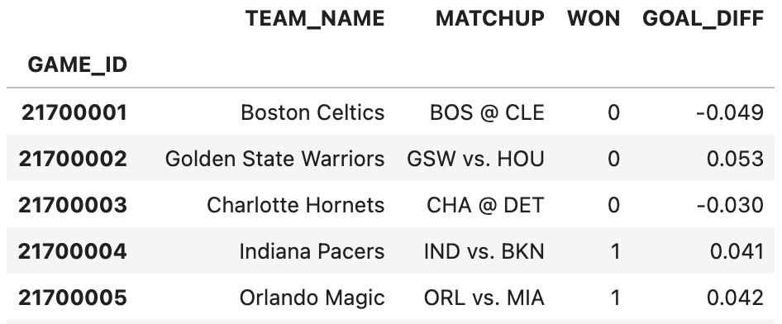
The games Dataset
The games dataset describes the win/loss results of basketball teams.
Difference in field goal success rate between teams
If a team won their game, we say they are in “Class 1”

Slide 13
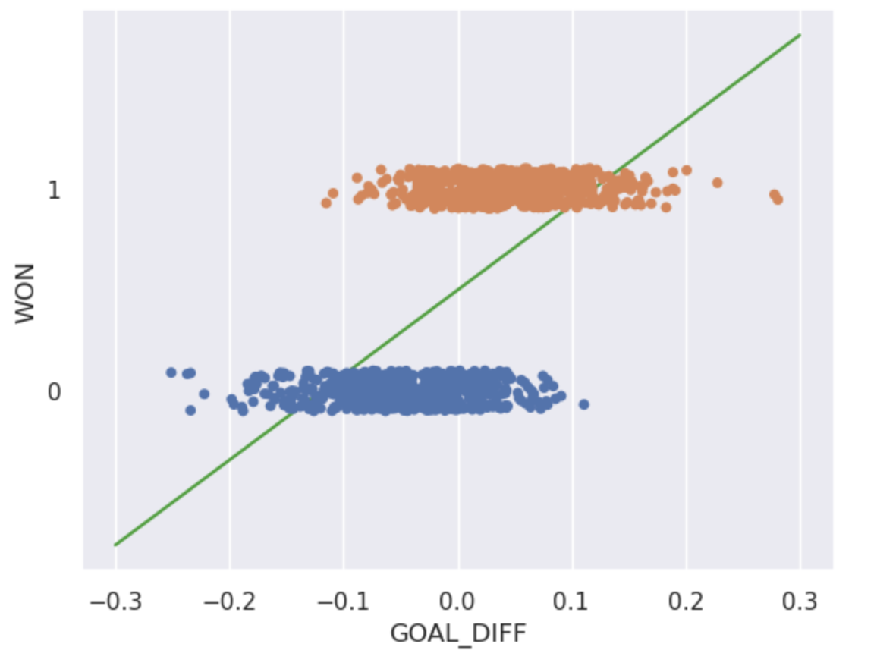

Why Not Least Squares Linear Regression?
I suppose it is tempting, if the only tool you have is a hammer, to treat everything as if it were a nail. – Abraham Maslow, The Psychology of Science
Problems:
The output can be outside the label range {0, 1}.
Some outputs can’t be interpreted: what does a class of “-2.3” mean?

Slide 14
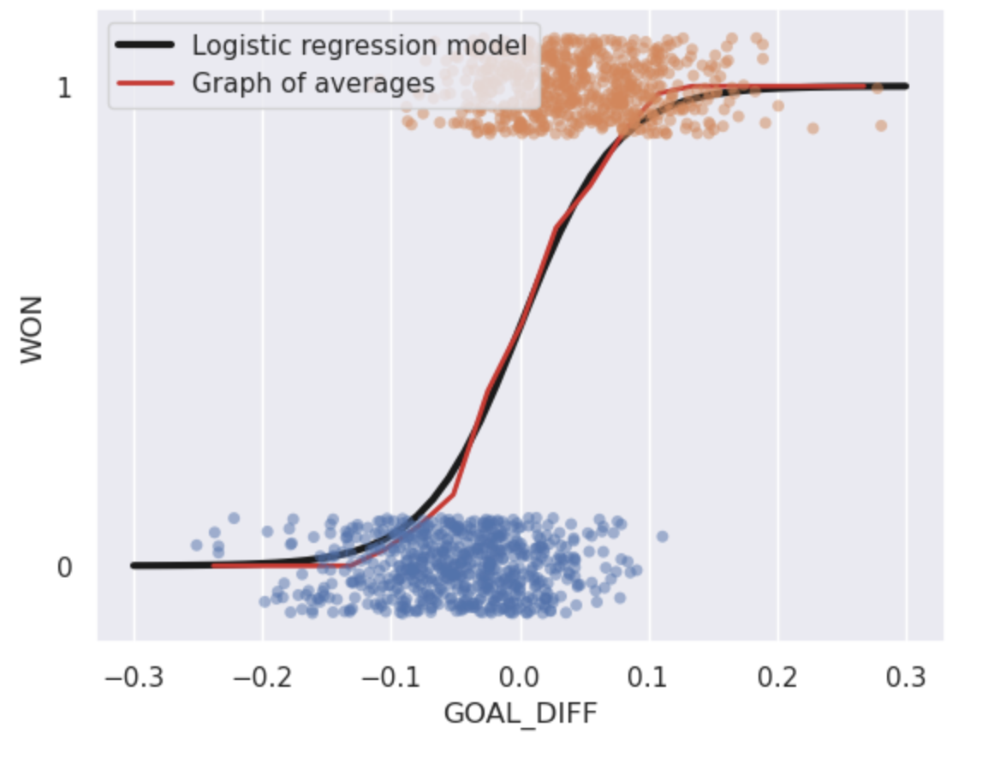
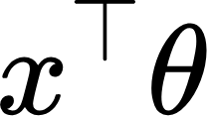
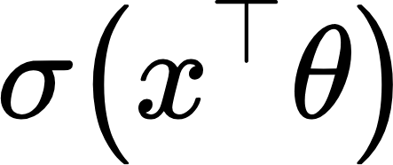
Logistic Regression Model
To predict a probability:
Compute a linear combination of the features,
Apply the sigmoid function

Slide 15
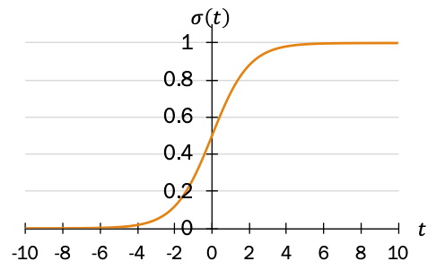
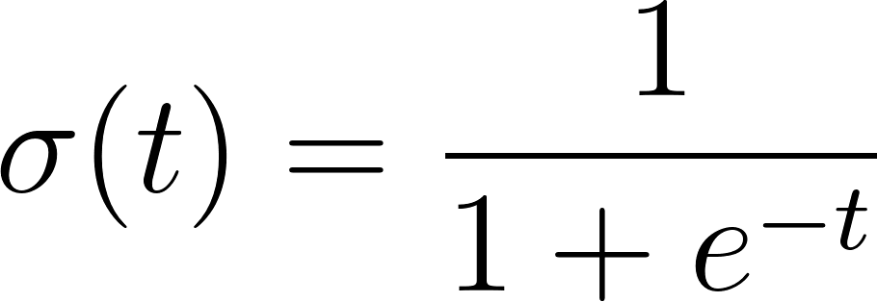
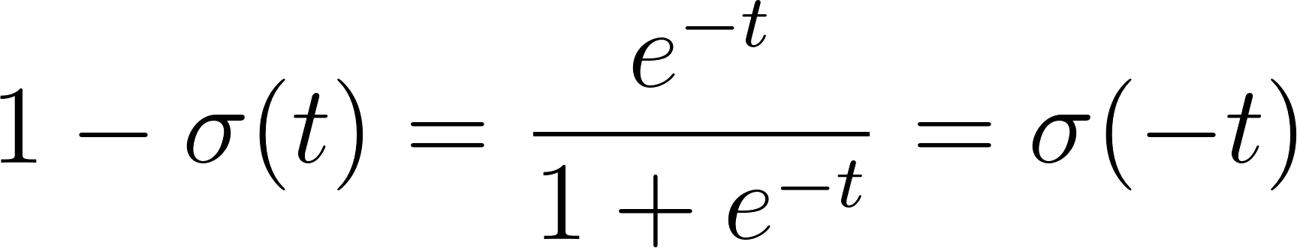

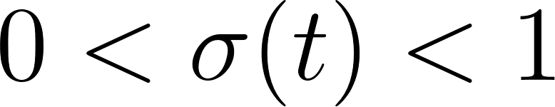
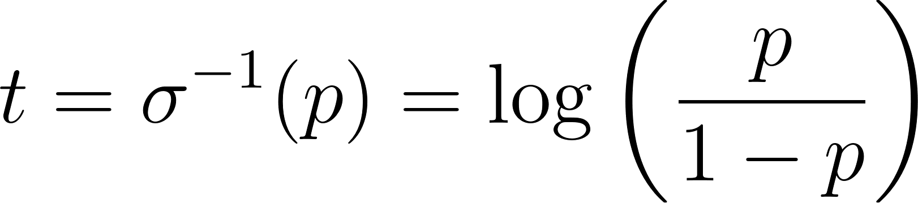
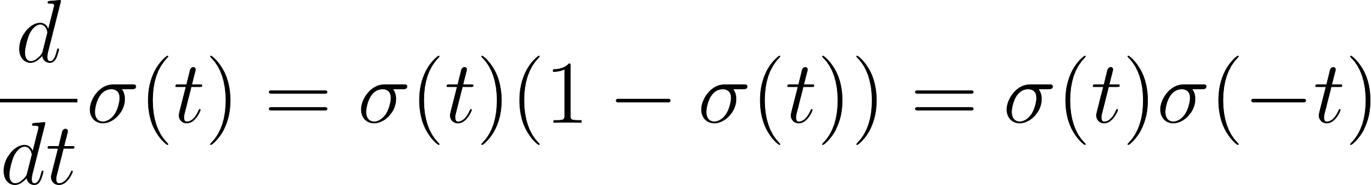
The Sigmoid Function
The S-shaped curve is formally known as the sigmoid function.
Domain
Range
Reflection/ Symmetry
Derivative
Inverse

Slide 16
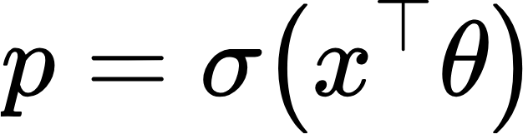
The Sigmoid Converts Numerical Features to Probabilities
Win?
If p > 0.5: predict a win
Other: predict a loss
Decision rule
Output: class
Model: linear combination transformed by activation function
Input: numeric features
In logistic regression, the sigmoid transforms a linear combination of numerical features into a probability.

Slide 17
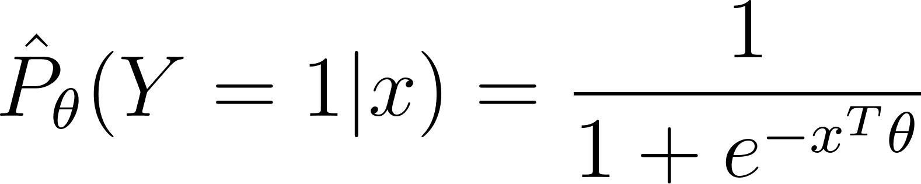
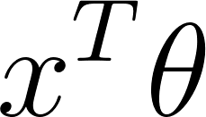
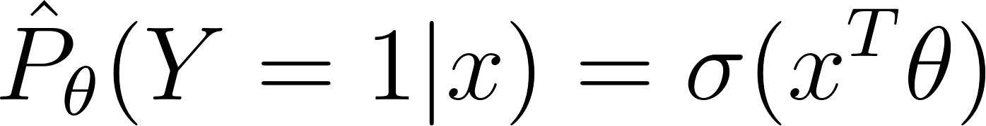
Formalizing the Logistic Regression Model
Estimated probability that given the features x, the response is 1
Logistic function 𝜎( ) at the value
The logistic regression model is most commonly written as follows:
Looks like linear regression. Now wrapped with 𝞼( )!
🎉

Slide 18
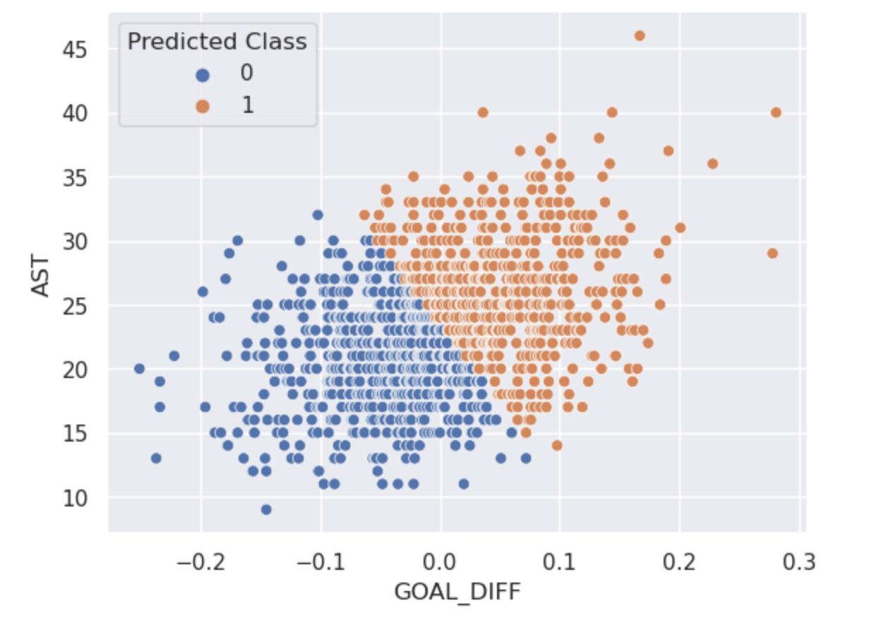
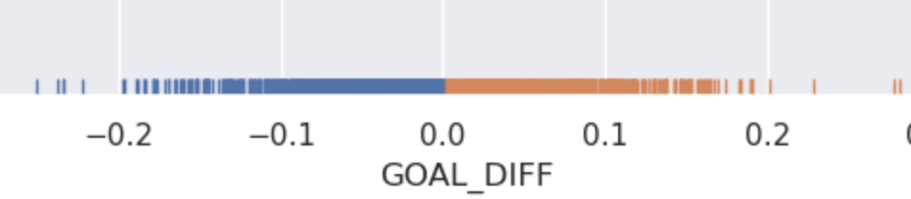
Decision Boundaries
A decision boundary describes the “line” the splits the data into classes based on its features.
For logistic regression, the decision boundary is a hyperplane: a linear combination of the features in p-dimensions.
This side of boundary: predict 1
This side of boundary: predict 1
1 feature: decision boundary is a 1D point
2 features: decision boundary is a 2D line

Slide 19
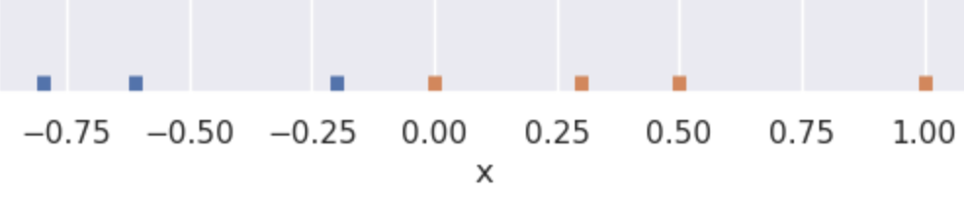
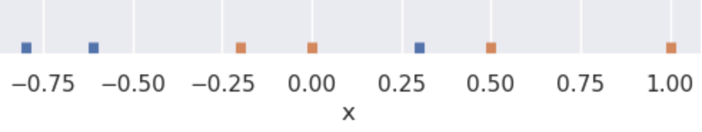
Linear Separability
A classification dataset is said to be linearly separable if there exists a hyperplane among input features x that separates the two classes y.
If there is one feature, look for a point that separates the classes.
separable
not separable

Slide 20
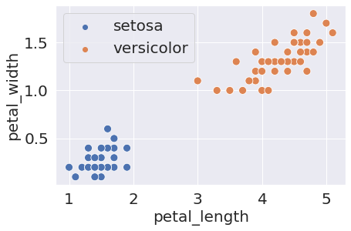
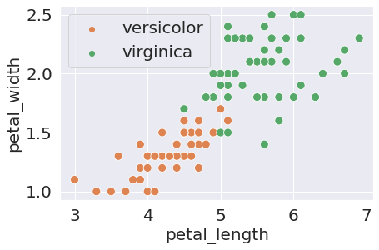
Linear Separability
A classification dataset is said to be linearly separable if there exists a hyperplane among input features x that separates the two classes y.
If there is one feature, look for a point that separates the classes.
separable
not separable
If there are two features, look for a line that separates the classes
separable
not separable

Slide 21
Cross-Entropy Loss
Regression vs. Classification
The Logistic Regression Model
Cross-Entropy Loss

Slide 22
The Modeling Process
Regression ( )
Classification ( )
✅
1. Choose a model
Linear Regression
Logistic Regression
2. Choose a loss function
Squared Loss or Absolute Loss
??
3. Fit the model
Regularization Sklearn/Gradient descent
Regularization Sklearn/Gradient descent
4. Evaluate model performance
??
(next time)
R², Residuals, etc.

Slide 23
The Modeling Process
Regression ( )
Classification ( )
✅
1. Choose a model
Linear Regression
Logistic Regression
2. Choose a loss function
Can squared loss still work?
Squared Loss or Absolute Loss
3. Fit the model
Regularization Sklearn/Gradient descent
Regularization Sklearn/Gradient descent
4. Evaluate model performance
??
(next time)
R², Residuals, etc.

Slide 24

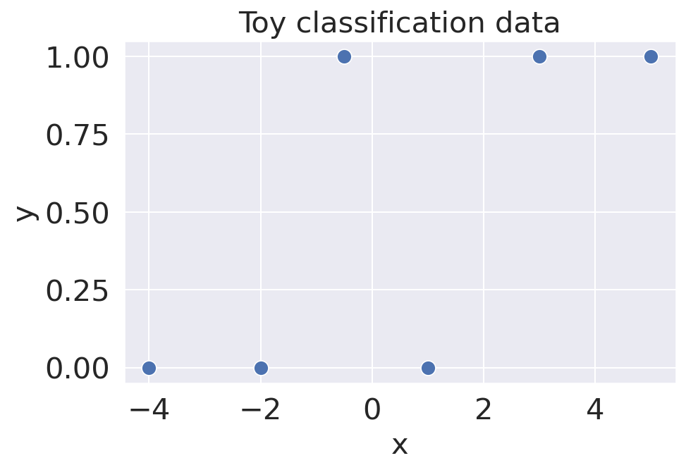
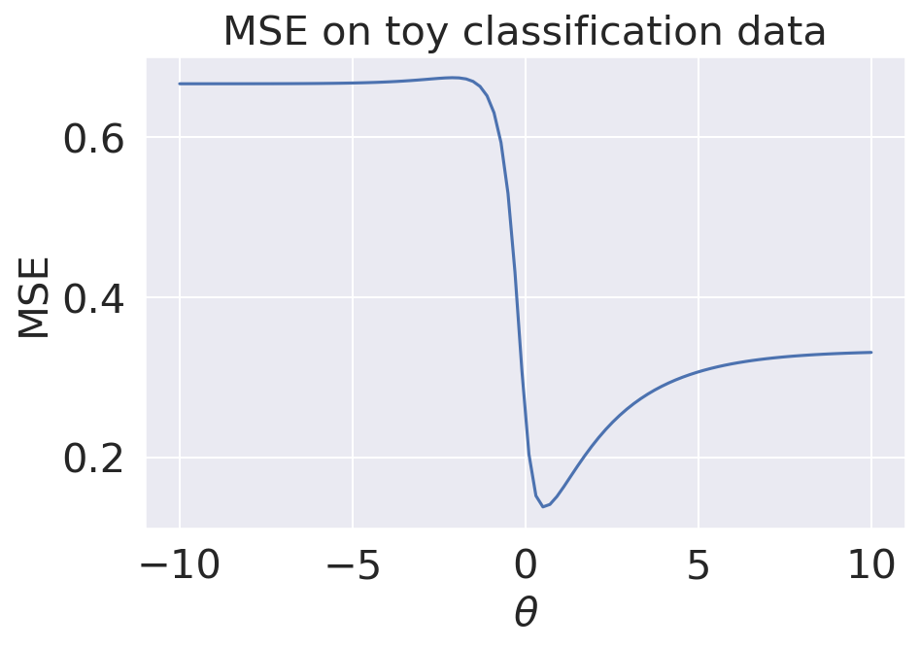
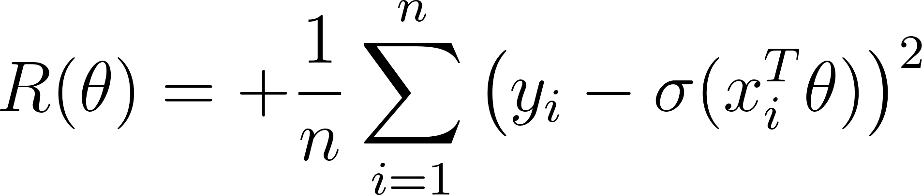
Toy Dataset: L2 Loss
Logistic Regression model:
Assume no intercept. So x, θ both scalars.
Mean Squared Error:
The MSE loss surface for logistic regression has many issues!
⚠️

Slide 25
Choosing a Different Loss Function
Regression ( )
Classification ( )
✅
1. Choose a model
Linear Regression
Logistic Regression
2. Choose a loss function
Cross-Entropy Loss
Squared Loss or Absolute Loss
3. Fit the model
Regularization Sklearn/Gradient descent
Regularization Sklearn/Gradient descent
4. Evaluate model performance
??
(next time)
R², Residuals, etc.

Slide 26
Loss in Classification
Let y be a binary label {0, 1}, and p be the model’s predicted probability of the label being 1.
In a classification task, how do we want our loss function to behave?
When the true y is 1, we should incur low loss when the model predicts large p.
When the true y is 0, we should incur high loss when the model predicts large p.
In other words, the behavior we need from our loss function depends on the value of the true class, y.

Slide 27
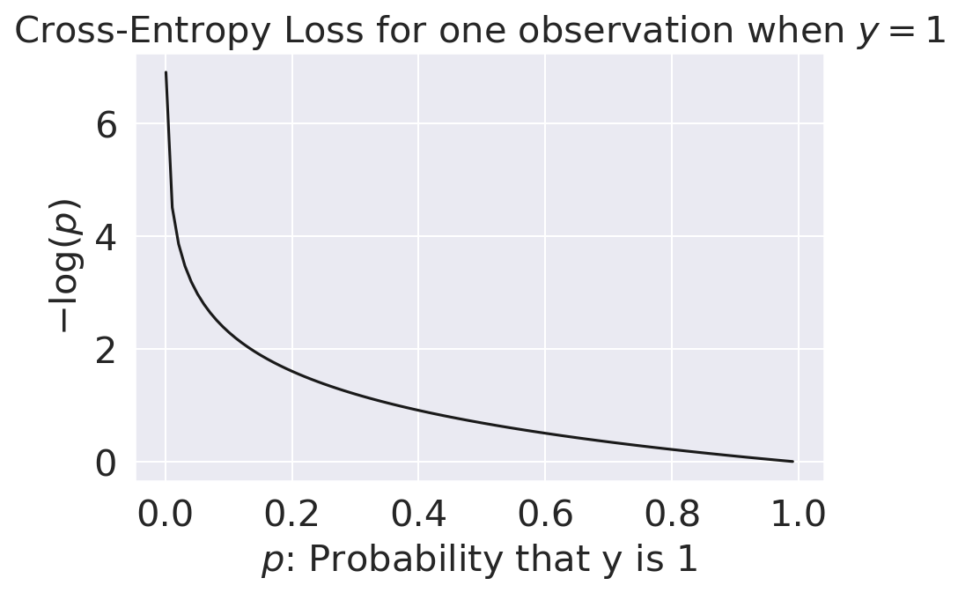
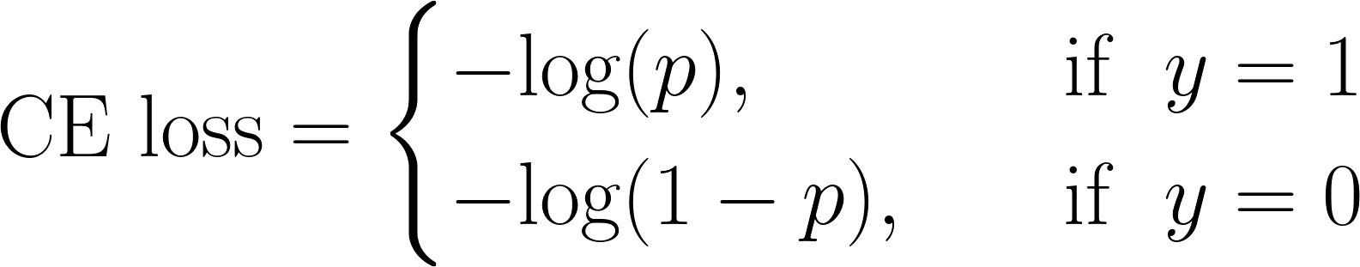
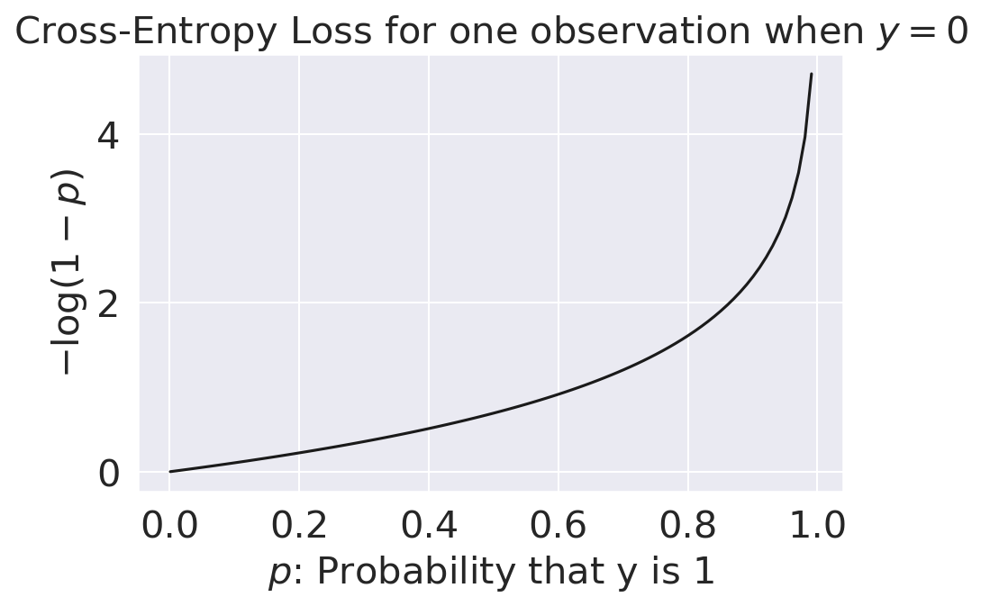
Cross-Entropy Loss
Let y be a binary label {0, 1}, and p be the probability of the label being 1.
The cross-entropy loss is defined as:
For y = 1,
p → 0: ∞ loss
p → 1: zero loss
For y = 0,
p → 0: zero loss
p → 1: ∞ loss

Slide 28
Cross-Entropy Loss: Two Loss Functions In One!
The piecewise loss function we introduced just then is difficult to optimize – we don’t want to check “which” loss to use at each step of optimizing theta.
Cross-entropy loss can be equivalently expressed as:
makes loss positive
for y = 1, only this term stays
for y = 0, only this term stays

Slide 29
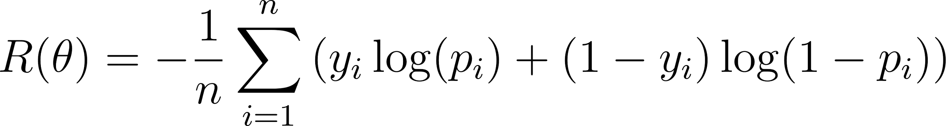
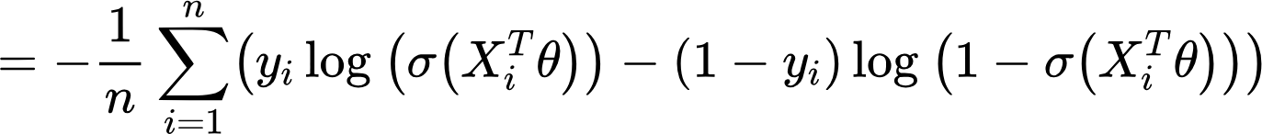
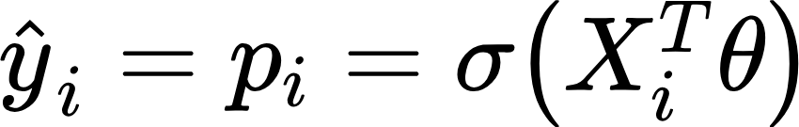

Empirical Risk: Average Cross-Entropy Loss
[Recall our model is ]
The optimization problem is therefore to find the estimate that minimizes R(θ):

Slide 30
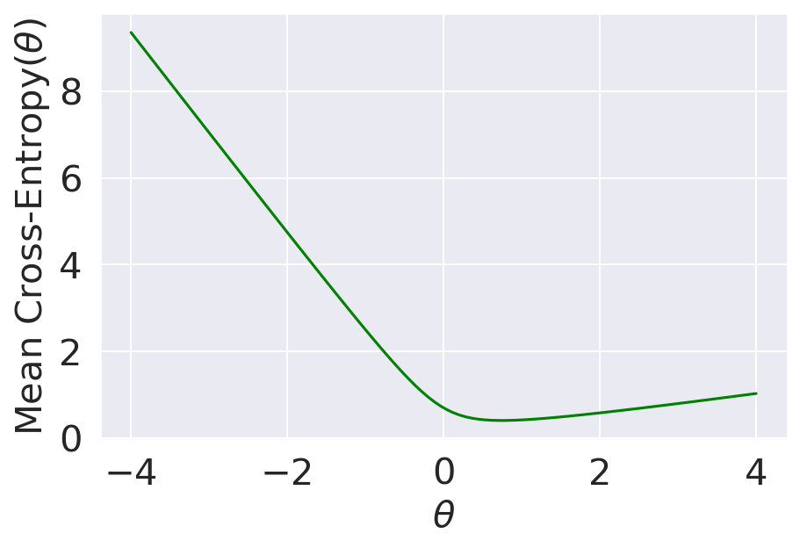
Convexity Proof By Picture
Squared Loss Surface
Cross-Entropy Loss Surface
A straight line crosses the curve Non-convex
Convex!

Slide 31
Maximum Likelihood Estimation
It may have seemed like we just pulled cross-entropy loss out of thin air.
CE loss is justified by a probability analysis technique called maximum likelihood estimation. Read on if you would like to learn more.
Recorded walkthrough: link.

Slide 32
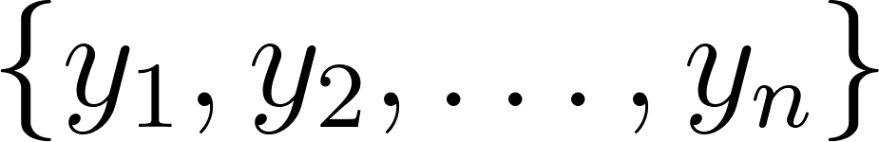

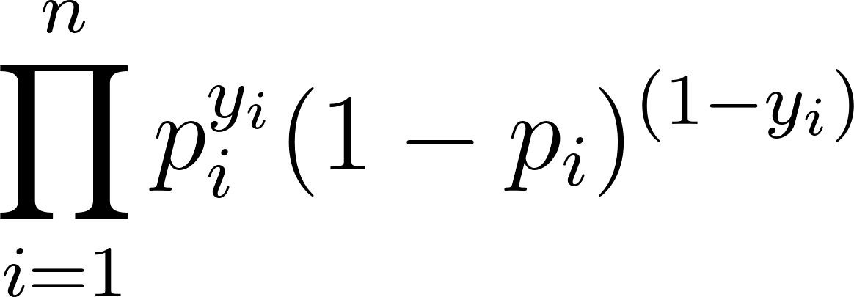
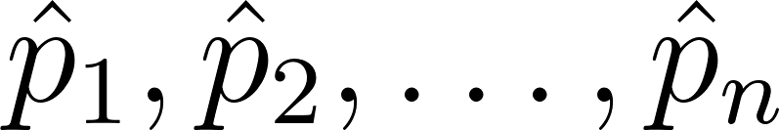
Maximum Likelihood Estimation (MLE)
Our maximum likelihood estimation problem:
For i = 1, 2, …, n, let Y_{i} be independent Bernoulli(p_{i}) and Observed data
We’d like to estimate .
Find that maximize

Slide 33
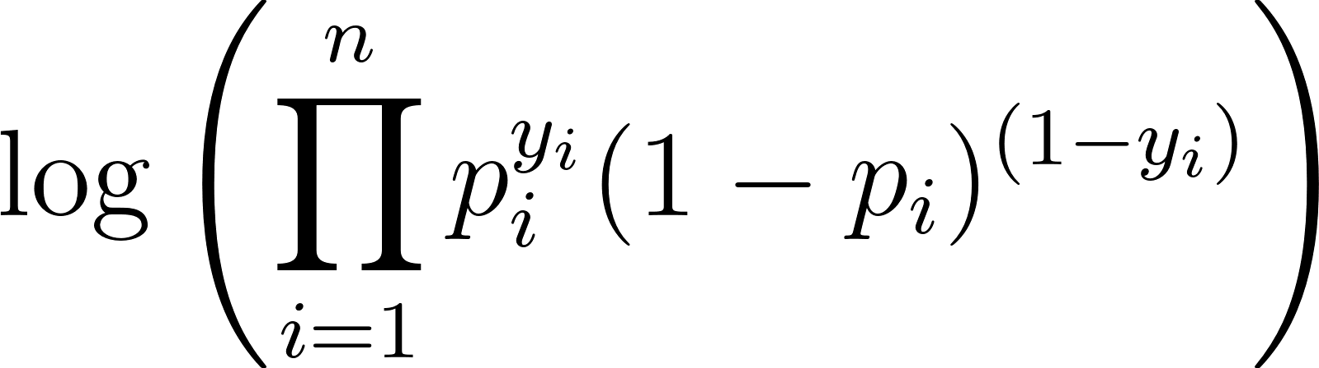
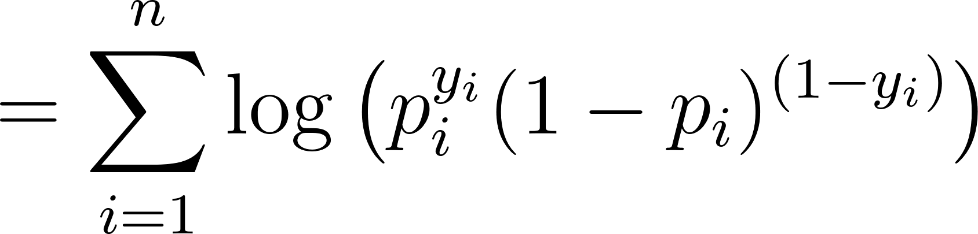
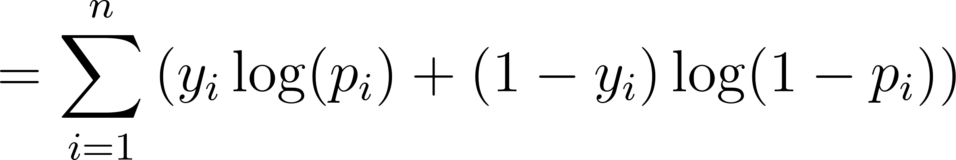
Maximum Likelihood Estimation (MLE)
Our maximum likelihood estimation problem:
For i = 1, 2, …, n, let Y_{i} be independent Bernoulli(p_{i}). Observed data .
We’d like to estimate .
Find that maximize
maximize
(log is an increasing function. If a > b, then log(a) > log(b).)

Slide 34
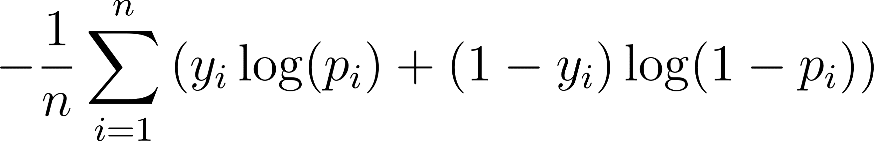
Maximum Likelihood Estimation (MLE)
maximize
(log is an increasing function. If a > b, then log(a) > log(b).)
minimize

Slide 35
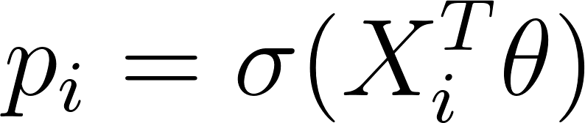
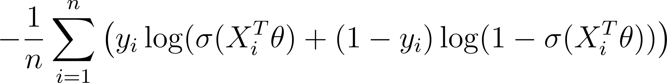

Maximizing Likelihood == Minimizing Average Cross-Entropy
maximize
Log is increasing; max/min properties
Minimizing cross-entropy loss is equivalent to maximizing the likelihood of the training data.
We are choosing the model parameters that are “most likely”, given this data.
Assumption: all data drawn independently from the same logistic regression model with parameter θ
minimize
For logistic regression, let
minimize
Cross-Entropy Loss!!

Slide 36
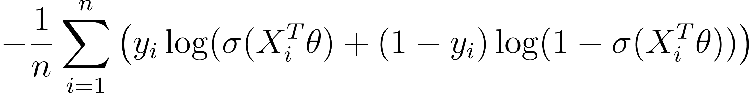
We Did it!
Regression ( )
Classification ( )
✅
1. Choose a model
Linear Regression
Logistic Regression
✅
2. Choose a loss function
Average Cross-Entropy Loss
Squared Loss or Absolute Loss
3. Fit the model
Regularization Sklearn/Gradient descent
Regularization Sklearn/Gradient descent
4. Evaluate model performance
??
(next time)
R², Residuals, etc.

Slide 37
Why More Performance Metrics?
We’ve already introduced cross-entropy loss – why do we need additional ways of assessing how well our models perform?
In linear regression, we made numerical predictions and used a loss function to determine how “good” these predictions were.
In logistic regression, our ultimate goal is to classify data – we are more concerned with whether or not each datapoint was assigned the correct class using the decision rule.
The performance metrics we are about to introduce will assess the quality of classifications, not the predicted probabilities.

Slide 38

Classifier Accuracy
Now that we actually have our classifier, let’s try and quantify how well it performs.
The most basic evaluation metric for a classifier is accuracy.
def accuracy(X, Y):
return np.mean(model.predict(X) == Y)
accuracy(X, Y) # 0.794
model.score(X, Y) # 0.794
(sklearn documentation)
While widely used, the accuracy metric is not so meaningful when dealing with class imbalance.

Slide 39
Pitfalls of Accuracy: A Case Study
Suppose we’re trying to build a classifier to filter spam emails (Project B!).
Each email is spam (1) or ham (0).
Let’s say we have 100 emails, of which only 5 are truly spam, and the remaining 95 are truly ham.
Your friend (“Friend 1”):
Classify every email as ham (0).
What is the accuracy of your friend’s classifier?
Is accuracy a good metric of this classifier’s performance?
🤔

Slide 40
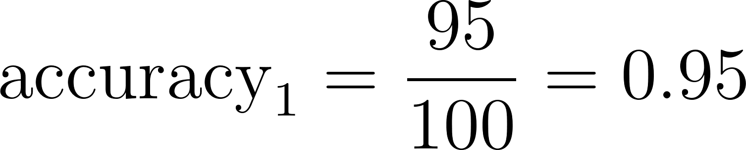
Pitfalls of Accuracy: A Case Study
Suppose we’re trying to build a classifier to filter spam emails.
Each email is spam (1) or ham (0).
Let’s say we have 100 emails, of which only 5 are truly spam, and the remaining 95 are ham.
Your friend (“Friend 1”):
Classify every email as ham (0).
High accuracy… …but we detected none ⚠️ of the spam!!!

Slide 41
Pitfalls of Accuracy: A Case Study
Suppose we’re trying to build a classifier to filter spam emails.
Each email is spam (1) or ham (0).
Let’s say we have 100 emails, of which only 5 are truly spam, and the remaining 95 are ham.
Accuracy is not always a good metric for classification, particularly when your data have class imbalance (e.g., very few 1’s compared to 0’s).
High accuracy… …but we detected none ⚠️ of the spam!!!

Slide 42





Types of Classifications
There are four different classifications that our model might make:
True positive: correctly classify a positive point as being positive ( )
False positive: incorrectly classify a negative point as being positive ( )
False negative: incorrectly classify a positive point as being negative ( )
True negative: correctly classify a negative point as being negative ( )
“positive” means a prediction of 1. “negative” means a prediction of 0.
Prediction
 | 0 | 1
0 | True negative (TN) | False positive (FP)
1 | False negative (FN) | True positive (TP)
Actual
A confusion matrix plots these quantities for a particular classifier and dataset.

Slide 43
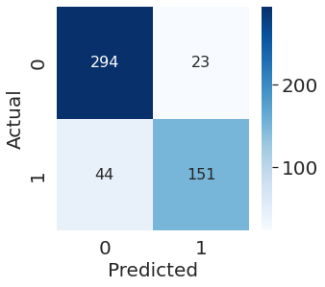
Types of Classifications
A confusion matrix plots these quantities for a particular classifier and dataset.
In sklearn:
from sklearn.metrics import confusion_matrix
cm = confusion_matrix(Y_true, Y_pred)

Slide 44

Accuracy, Precision, and Recall
What proportion of points did our classifier classify correctly?
Prediction
 | 0 | 1
0 | TN | FP
1 | FN | TP
Actual
Notes:
Precision captures the accuracy of the model when it is positive. Higher precision models are often more likely to predict that true things are negative (higher false negative rate).
Recall captures the ability of the model to predict true on all the true examples. Higher recall runs the risk of predicting true on false examples.

Slide 45

Accuracy, Precision, and Recall
What proportion of points did our classifier classify correctly?
Prediction
 | 0 | 1
0 | TN | FP
1 | FN | TP
Precision and recall are two commonly used metrics that measure performance even in the presence of class imbalance.
Actual
Of all observations that were predicted to be 1, what proportion were actually 1?
How precise is our classifier when it is positive?
Penalizes false positives.
Notes:
Precision captures the accuracy of the model when it is positive. Higher precision models are often more likely to predict that true things are negative (higher false negative rate).
Recall captures the ability of the model to predict true on all the true examples. Higher recall runs the risk of predicting true on false examples.

Slide 46

Accuracy, Precision, and Recall
What proportion of points did our classifier classify correctly?
Prediction
 | 0 | 1
0 | TN | FP
1 | FN | TP
Actual
Precision and recall are two commonly used metrics that measure performance even in the presence of class imbalance.
Of all observations that were predicted to be 1, what proportion were actually 1?
How accurate is our classifier when it is positive?
Penalizes false positives.
Of all observations that were actually 1, what proportion did we predict to be 1? (Also known as sensitivity.)
How sensitive is our classifier to positives?
Penalizes false negatives.
Notes:
Precision captures the accuracy of the model when it is positive. Higher precision models are often more likely to predict that true things are negative (higher false negative rate).
Recall captures the ability of the model to predict true on all the true examples. Higher recall runs the risk of predicting true on false examples.

Slide 47


One of the Most Valuable Graphics on Wikipedia
(*i.e., true class is 1)
(i.e., positive; predicted class is 1)
[adapted from Wikipedia]

Slide 48


Back to the Spam
Suppose we’re trying to build a classifier to filter spam emails.
Each email is spam (1) or ham (0).
Let’s say we have 100 emails, of which only 5 are truly spam, and the remaining 95 are ham.
Your friend:
Classify every email as ham (0).
 | 0 | 1
0 | TN: 95 | FP: 0
1 | FN: 5 | TP: 0

Slide 49



Back to the Spam
Suppose we’re trying to build a classifier to filter spam emails.
Each email is spam (1) or ham (0).
Let’s say we have 100 emails, of which only 5 are truly spam, and the remaining 95 are ham.
 | 0 | 1
0 | TN: 0 | FP: 95
1 | FN: 0 | TP: 5
Your friend:
Classify every email as ham (0).
Your other friend (“Friend 2”):
Classify every email as spam (1).
Many false positives!
No false negatives!

Slide 50
Precision vs. Recall
Precision penalizes false positives, and Recall penalizes false negatives.
This suggests that there is a tradeoff between precision and recall; they are often inversely related.
Ideally, both would be near 100%, but that’s unlikely to happen.

Slide 51
Which Performance Metric?
Precision penalizes false positives, and Recall penalizes false negatives.
In many settings, there might be a higher “cost” to missing positive or negative cases.
Some examples:
Detecting if someone tests positive (1) or negative (0) for a disease.
Determining if someone should be sentenced to prison (1) or not (0).
Filtering an email as spam (1) or ham (0).

Slide 52


True and False Positive Rates
Keeping things interesting – two more performance metrics.
False Positive Rate (FPR): out of all datapoints that had Y=0, how many did we classify incorrectly?
Prediction
 | 0 | 1
0 | TN | FP
1 | FN | TP
Actual
True Positive Rate (TPR): out of all datapoints that had Y=1, how many did we classify correctly? Same as recall.

Slide 53
Adjusting the Classification Threshold

Slide 54



Thresholds
We commonly make decision rules by specifying a threshold, . If the predicted probability is greater than , predict Class 1. Otherwise, predict Class 0.
What happens if we set T to something other than 0.5?

Slide 55

Changing the Threshold
As we increase the threshold T, we “raise the standard” of how confident our classifier needs to be to predict 1 (i.e., “positive”).
T = 0.25
T = 0.50
T = 0.75
These x will all predict 1
Fewer positives

Slide 56



Changing the Threshold
As we increase the threshold T, we “raise the standard” of how confident our classifier needs to be to predict 1 (i.e., “positive”).
T = 0.25
T = 0.50
T = 0.75

Slide 57

Changing the Threshold
T = 0.25
T = 0.50
T = 0.75
How to interpret a higher classification threshold: the model needs to predict a higher probability of a point belonging to Class 1 before it can confidently classify it as Class 1
As T increases, we predict fewer positives!
Changing the threshold allows us to finetune how “confident” we want our model to be before making a positive prediction

Slide 58
Precision-Recall Curves
Earlier, we noticed that there is a tradeoff between precision (penalizes false positives) and recall (penalizes false negatives).
We should choose a threshold that keeps both precision and recall high.
In a precision-recall curve, we:
Test out many different possible thresholds
For each threshold, compute the precision and recall of the classifier
Choose the threshold at the “corner” of the curve

Slide 59


Precision-Recall Curves
In a precision-recall curve, we:
Test out many different possible thresholds
For each threshold, compute the precision and recall of the classifier
We should choose a threshold that keeps both precision and recall high.

Slide 60

F measure
Combines precision and recall using harmonic mean, the traditional F-measure
$F= 2. \frac{precision.recall}{precision + recall}$

Slide 61

ROC Curves
We can perform a similar process with FPR and TPR
Try many thresholds
Compute the FPR and TPR for each threshold
Choose a threshold that keeps FPR low and TPR high
ROC = “receiver operating characteristic”, comes from radar in WWII
Threshold is low: FPR high, TPR high
(many positive predictions)
Threshold is high: FPR low, TPR low
(few positive predictions)

Slide 62
ROC Curves
A perfect predictor has TPR = 1 and FPR = 0
The Area Under Curve (AUC) of the perfect predictor is 1.
Because we want our classifier to be as close as possible to the perfect predictor, we aim to maximize the AUC.

Slide 63
ROC Curves
A predictor that predicts randomly has an AUC of 0.5

